Slide 1
Digital Explorer @ DSEi

Slide 2
The event
DSEi is the world’s largest joint defence and security event, held at the London Excel conference centre each year.
35,000+ global attendees visit the event from over 35 countries
DXC sponsored the VIP lounge and had 2 booths on the main show flow. The key themes being positioned by DXC where:
Future Workplace
Cyber Security
Digital Training (inc. a VR training application developed by HPi and RenderMedia)
Logistics and Supply
The VIP lounge was set-up to complement the DXC London Innovation Centre, with a large interactive video wall; which the team used to present, engage and analyse visitors digital challenges using the DXC Digital Explorer platform.

Slide 3
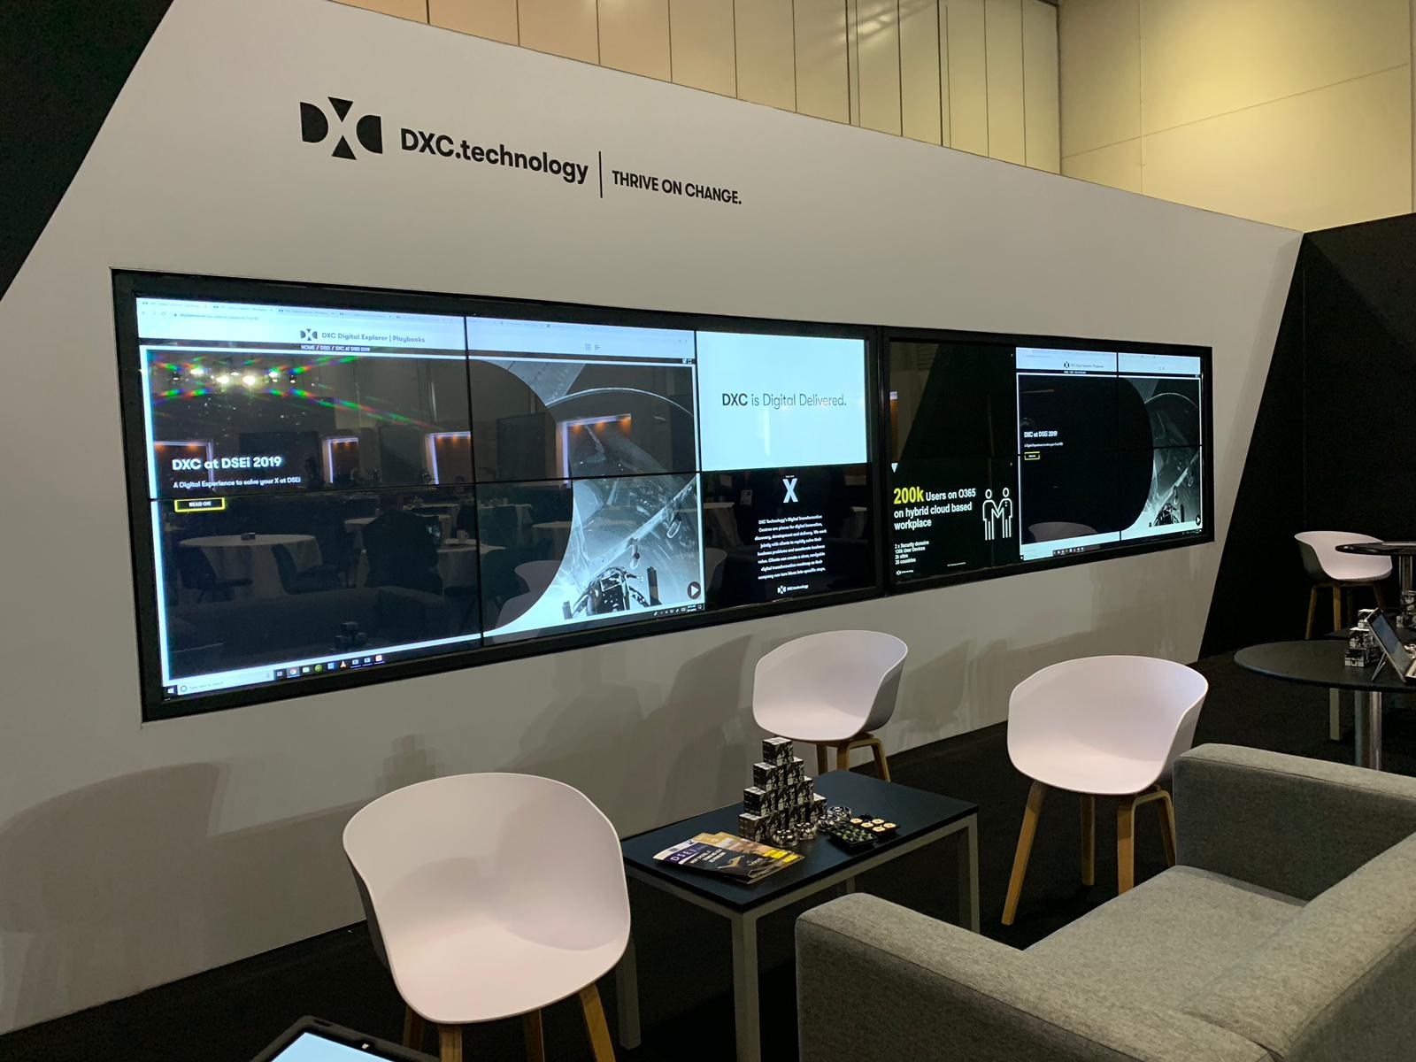
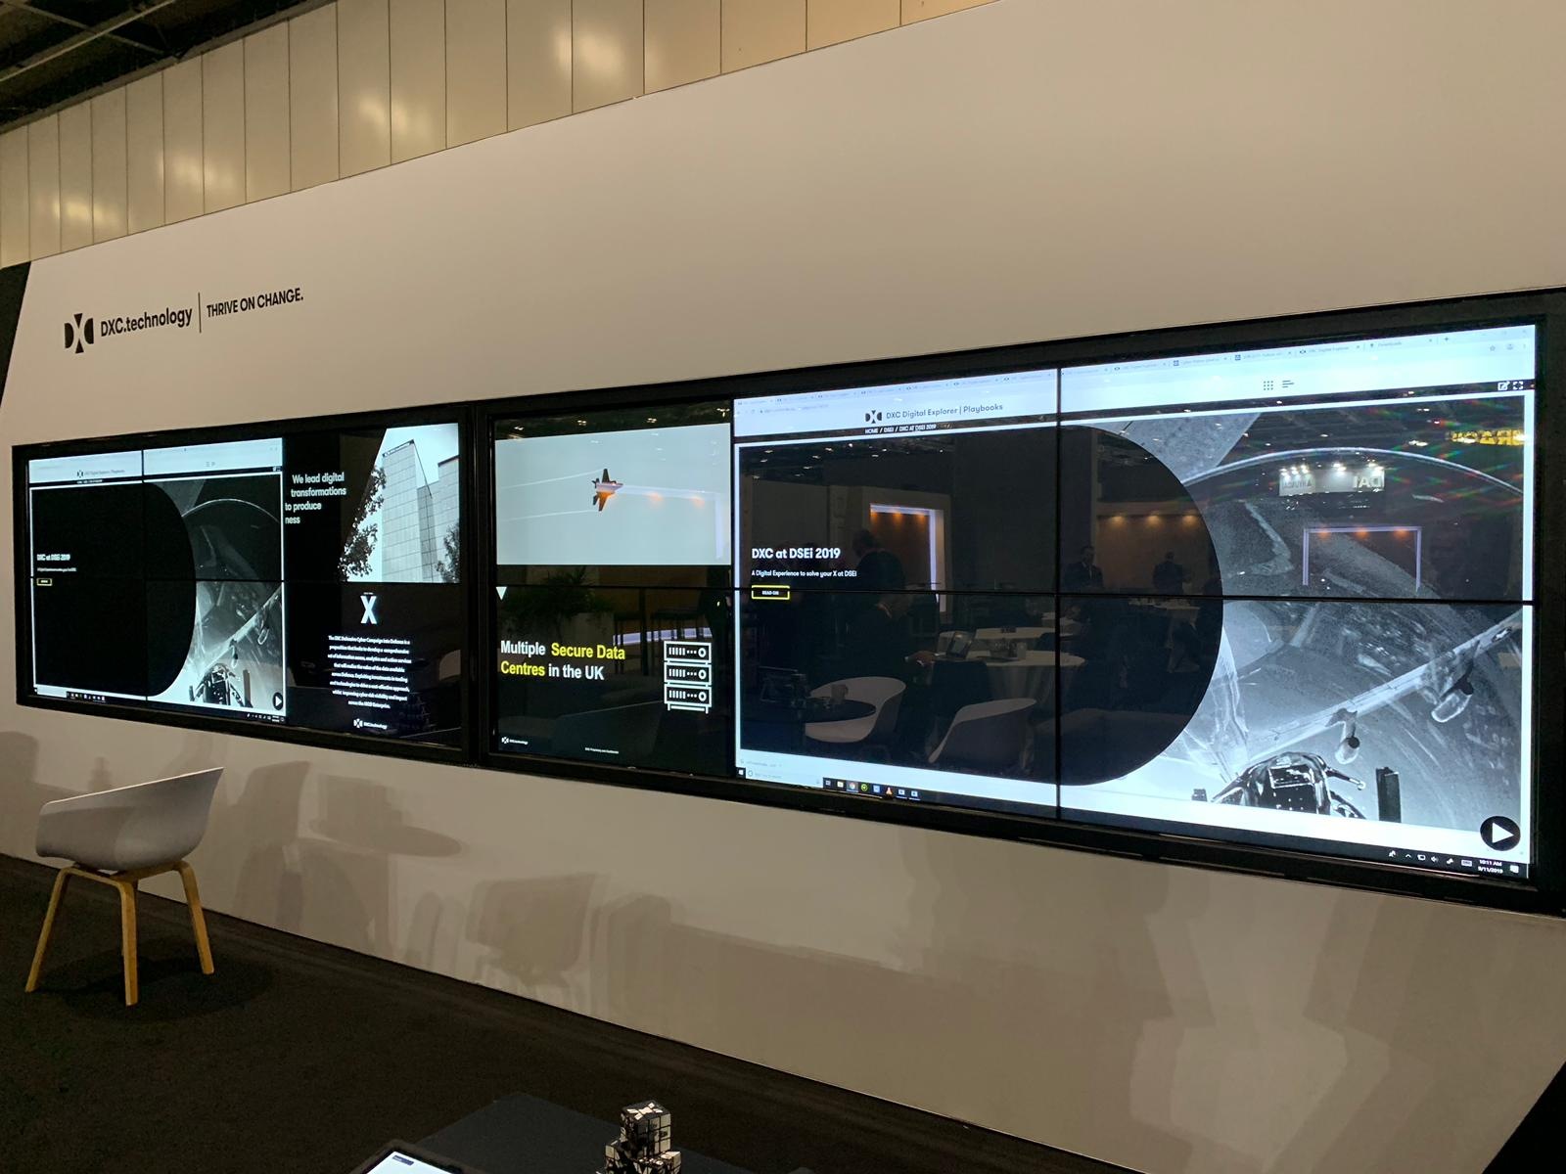
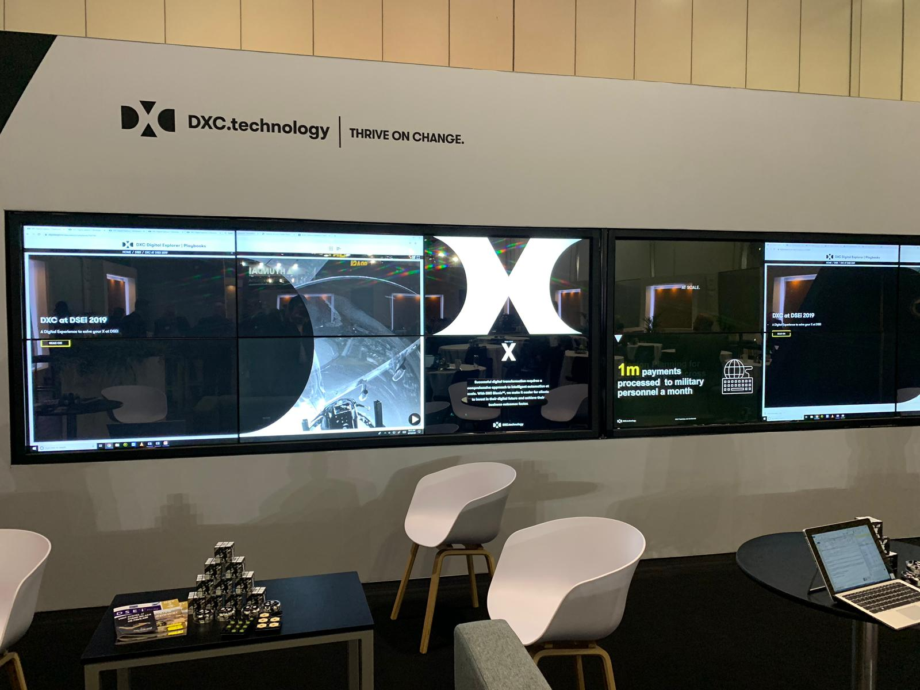
The VIP Lounge

Slide 4
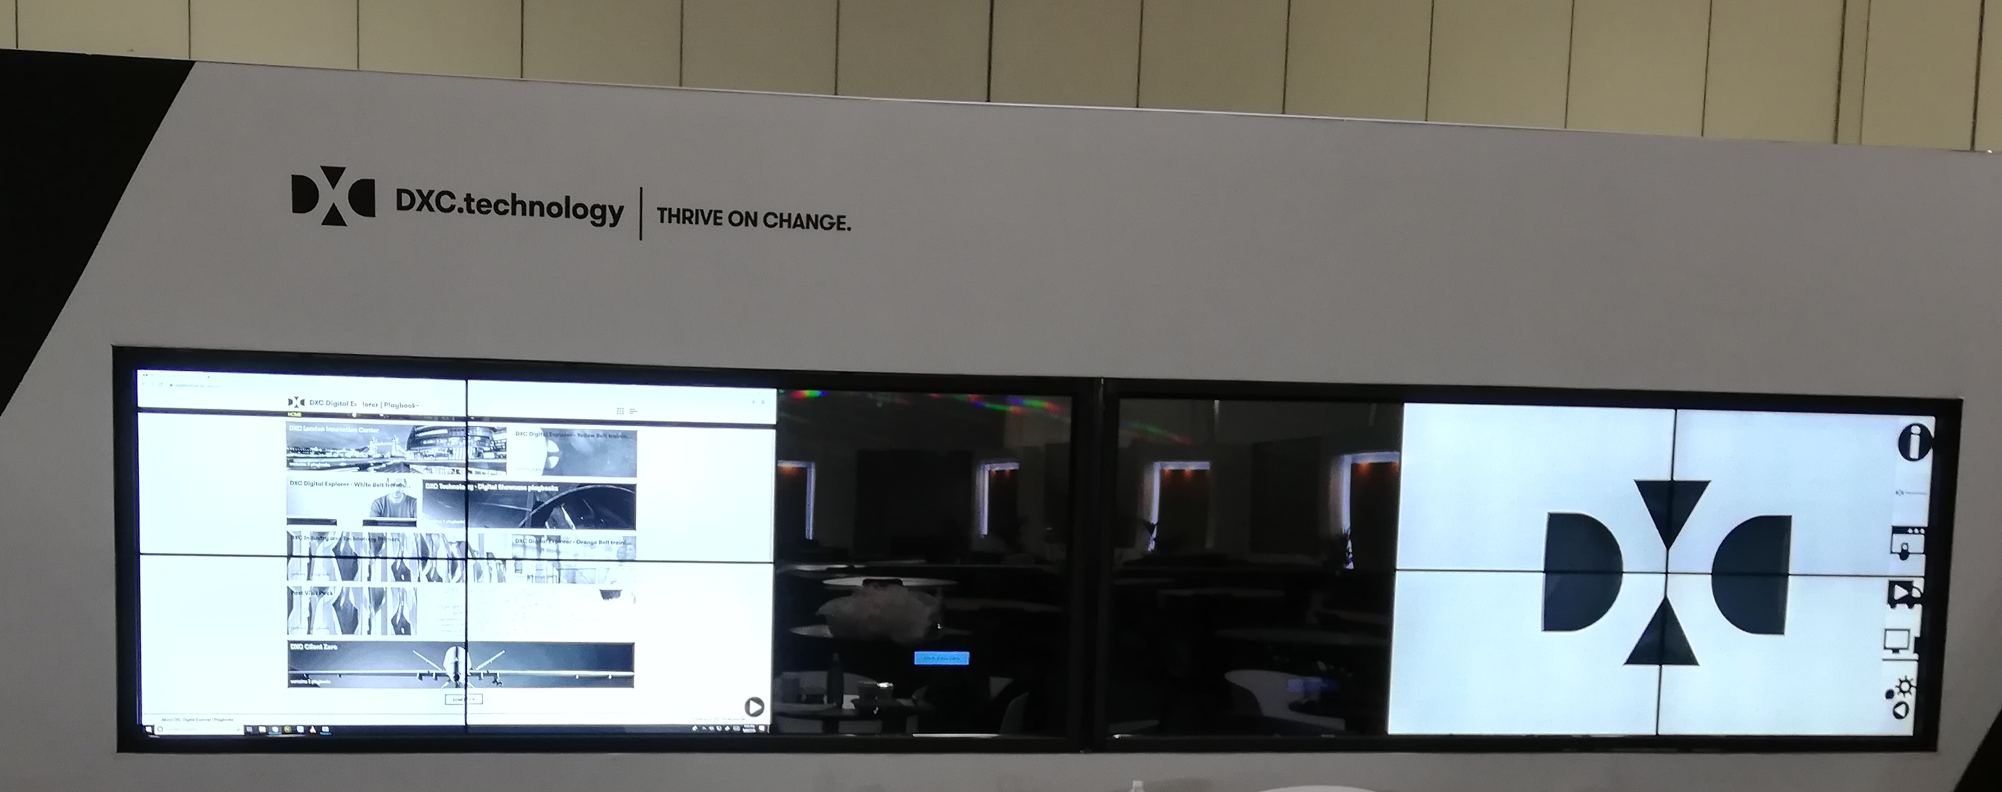
The DXC Video Wall
Digital Explorer
Various DXC Videos
Digital Explorer

Slide 5
The team
Paul O’Hanlon – Defence CT
Miles Hutton – Strategic Sales Executive
Dave Manning – Defence DSD
Michael Guest – Defence ACT
Vicki Corden - Marketing
Notes:
Note : I (David Stevens) was not involved in this at all! – the team completed the 3 training belts

Slide 6
DSEi Digital Journey
Understand the Client
Explain DXC’s Digital Transformation approach
Introductions
Conclude session
Draft Playbook
Complete and distribute
Create/Seed Workspace
Confirm key ideas
Conclude session
Discuss and Analyse
Develop Post DSEi
Develop Roadmap
Reference materials
Playbooks
Solutions
Workspaces
Trends
Roadmaps

Slide 7
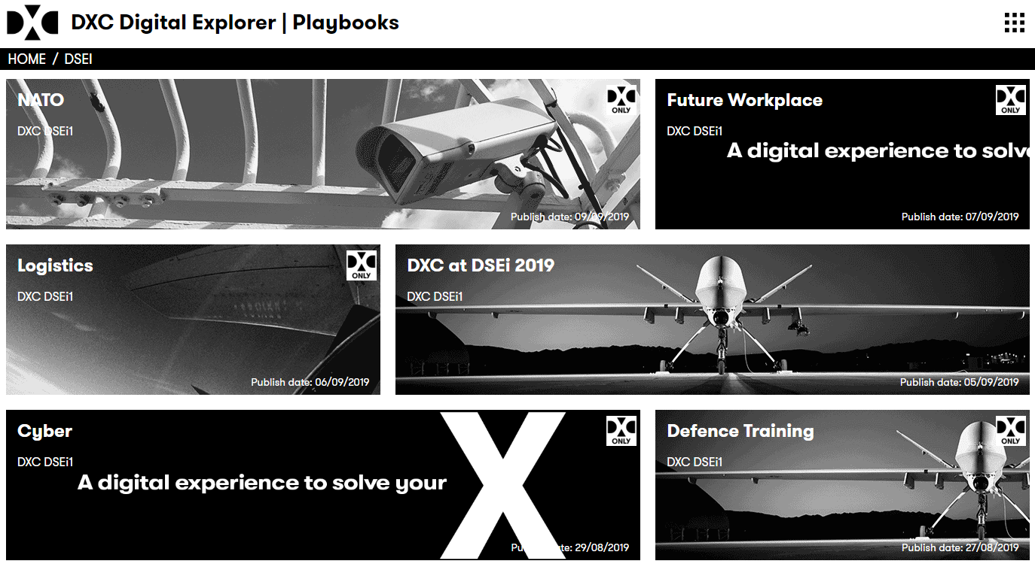
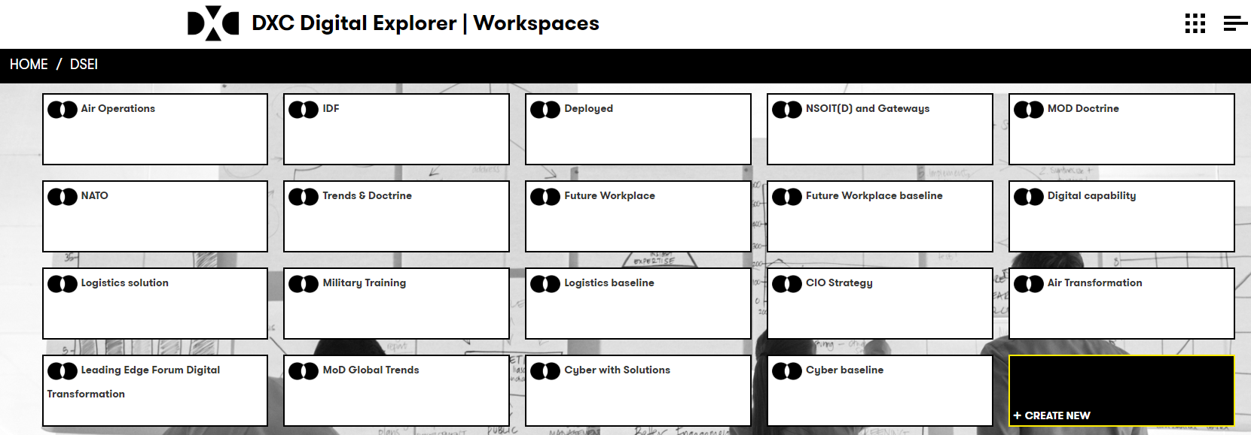
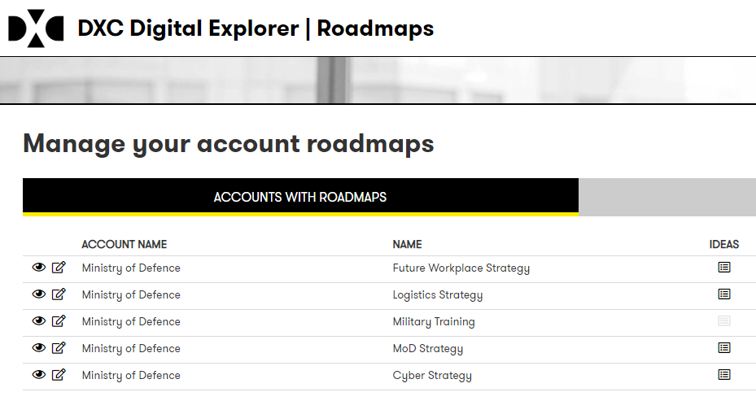
Content created
See the slide nodes for links
A set of 6 Playbooks
General introduction playbook, plus 5 detailed playbooks covering the conference themes
19 Workspaces
Analysed from key external material (e.g. UK MoD Global Trends, NSOIT)
5 Digital Roadmaps
Each outlining an example approach to support the 5 detailed scenarios/conference themes
Notes:
Playbook shelf : https://digitalexplorer.dxc.com/pb/playbook-shelf/762725
Workgroup : https://digitalexplorer.dxc.com/dew/workspace-group/761063
Roadmaps :
Future workplace : https://digitalexplorer.dxc.com/bvr/roadmaps/767358/summary
Logistics : https://digitalexplorer.dxc.com/bvr/roadmaps/766997/summary
Training : https://digitalexplorer.dxc.com/bvr/roadmaps/763781/summary
Strategy : https://digitalexplorer.dxc.com/bvr/roadmaps/763162/summary
Cyber : https://digitalexplorer.dxc.com/bvr/roadmaps/763173/summary

Slide 8
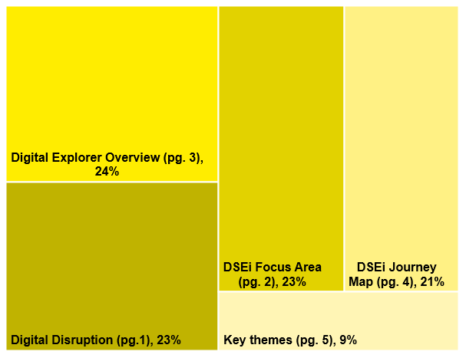
DE Numbers
Playbooks
DSEi Introduction Playbook: Time on page
Workspaces
Roadmaps
5
19
5
205 total views

Slide 9
Feedback
A hugely positive impact on our presence at the exhibition. The ability to readily articulate a Clients Business Need in front of them and to explore the impact that this might have on their plans and strategy hit the mark with a number of the MoD clients. Whilst we weren’t looking to sell DE to the MoD, its existence and features were a positive surprise to them.

Slide 10
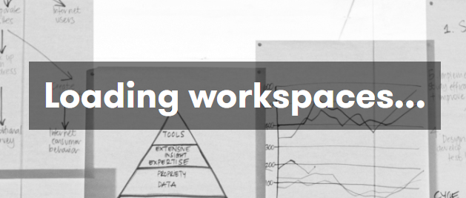
DE Issues list
Defects
Timeout issue : random “loading workspace” timeout issue. Resolved with control-R or F5 but shouldn’t happen (investigating)
Workspaces : module hangs if “add from” is used whilst in Graph or Compare view (resolved)
Solutions : industry values dropped during edit (resolved)
UX issues
Playbooks
Improve content page ~ give page titles for each page (added to backlog)
Easier return to frontpage (resolved)
Risk table – allow author to define the default table dimensions (added to backlog)
From a overall Digital Explorer viewpoint :
Issues and some defects where found, but the DSEi team worked with the DE product team. Bringing valued UX feedback and improvement suggestions.
They didn’t change direction

Slide 11
DE Suggestions
More freedom to add trends, signals and connections within the workspace canvas
Single viewpoint of all connected content (planned #340)

